Slide 1
Nagios Basics OALUG
Nick Brooks
evilpeno@gmail.com
04/26/2011

Slide 2
Introduction & Outline
Confessions:
I am not a Nagios Expert
I use Nagios in my day job
Outline:
Basic install
Basic configuration
Add Ons
Resources
Live Demo

Slide 3
Nagios Installation
Debian/Ubuntu
  aptitude install nagios3
CentOS/Fedora
  RPMForge

Slide 4
Basic Configuration
/etc/nagios3
  commands.cfg
  nagios.cfg
  resource.cfg
/etc/nagios3/conf.d
  contacts_nagios2.cfg
  generic-service_nagios2.cfg
  services_nagios2.cfg
  extinfo_nagios2.cfg
  hostgroups_nagios2.cfg
  timeperiods_nagios2.cfg
  generic-host_nagios2.cfg
  localhost_nagios2.cfg

Slide 5
Config File Hierarchy
Default config is default
*.cfg – recursively
Hierarchy should resemble “real life”
Use what makes sense to you and document it

Slide 6
Config File Hierarchy: Example
|-- commands
|-- computers
| |-- linux
| | `-- services
| `-- windows
|-- misc
`-- network
|-- firewalls
|-- links
|-- routers
`-- switches

Slide 7
NRPE
Remote execution of nagios plugins
  Linux
  Unix
  BSD
  Windows (uses NSClient)

Slide 8
Basic Configuration
/etc/nagios
  nrpe.cfg

Slide 9
NRPE Installation
Debian/Ubuntu
  aptitude install nagios-nrpe-server
CentOS/Fedora
  RPMForge

Slide 10
SNMP
If your device supports SNMP, you can monitor it

Slide 11
Addons
Nagios Exchange
  http://exchange.nagios.org/
  Pros:
    Over 2300 Listings
    >1900 plugins
  Cons:
    Varying quality and reliability
    Old, unmaintained, code rot, etc

Slide 12
Notifications
Notifications suck.
Email
SMS
IRC

Slide 13
Email Notification

Slide 14
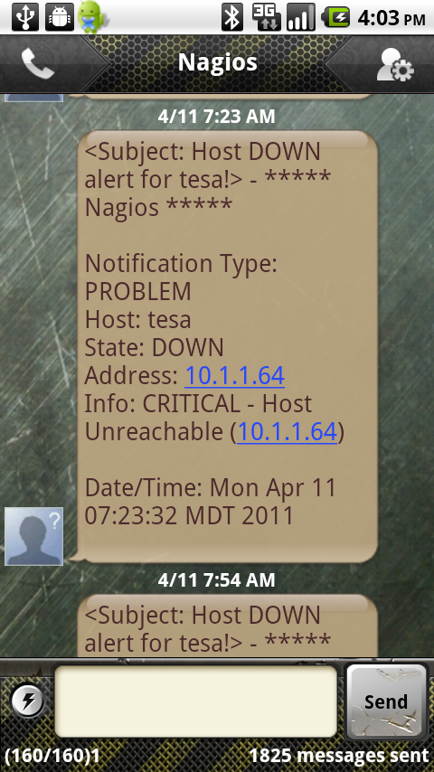
SMS Notification

Slide 15
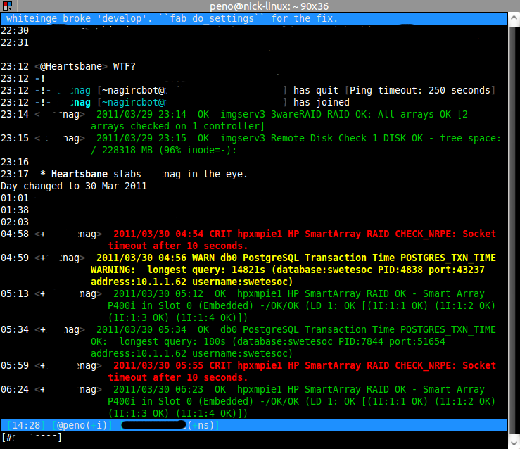
IRC Notification

Slide 16
Resources
http://nagios.org/documentation
http://www.nagiosbook.org/
http://exchange.nagios.org/
https://www.monitoringexchange.org/

Slide 17
Live Demo

